Slide 1
ITS Projects Lane Fukuda lanef@hawaii.edu

Slide 2
University of Hawaiʻi Strategic Directions 2015 - 2021
Hawaiʻi Graduation Initiative
Hawaiʻi Innovation Initiative
21st Century Facilities
High Performance Mission-Driven System

Slide 3
Information Technology Services Strategic Plan
Hawaiʻi Graduation Initiative
Support Student Success
Enhance Value of Data Assets
Hawaiʻi Innovation Initiative
Promote ITS as a Research Partner

Slide 4
Information Technology Services Strategic Plan
21st Century Facilities
Build Innovative Environments
High Performance Mission-Driven System
Deliver Value in Enterprise Systems
Foundational Infrastructure
Proactively Build Capacity
Improve ITS

Slide 5
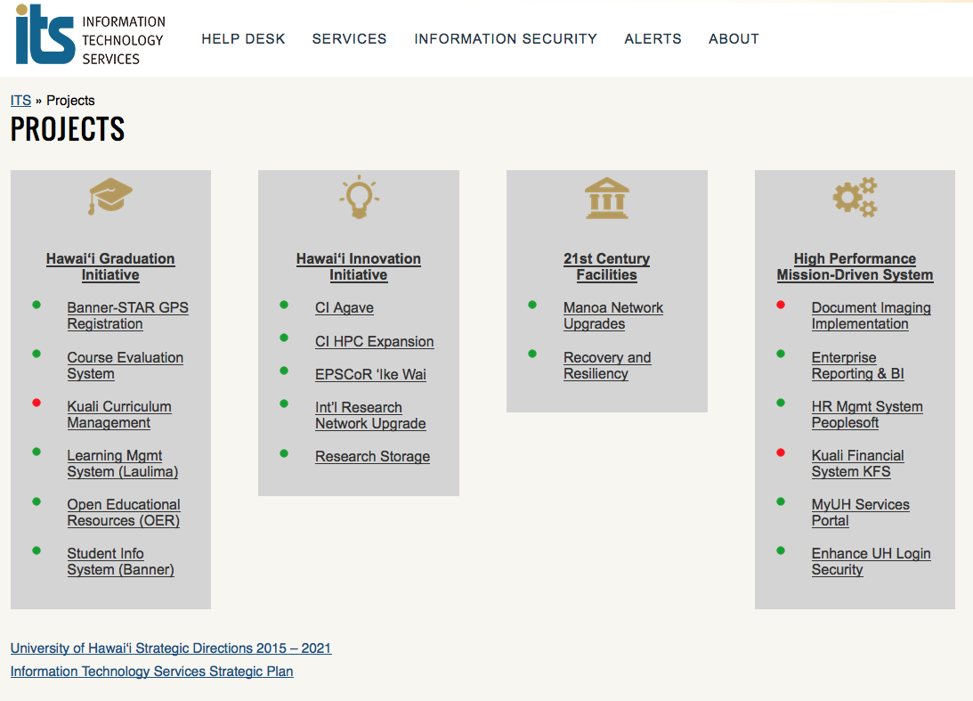

Slide 6
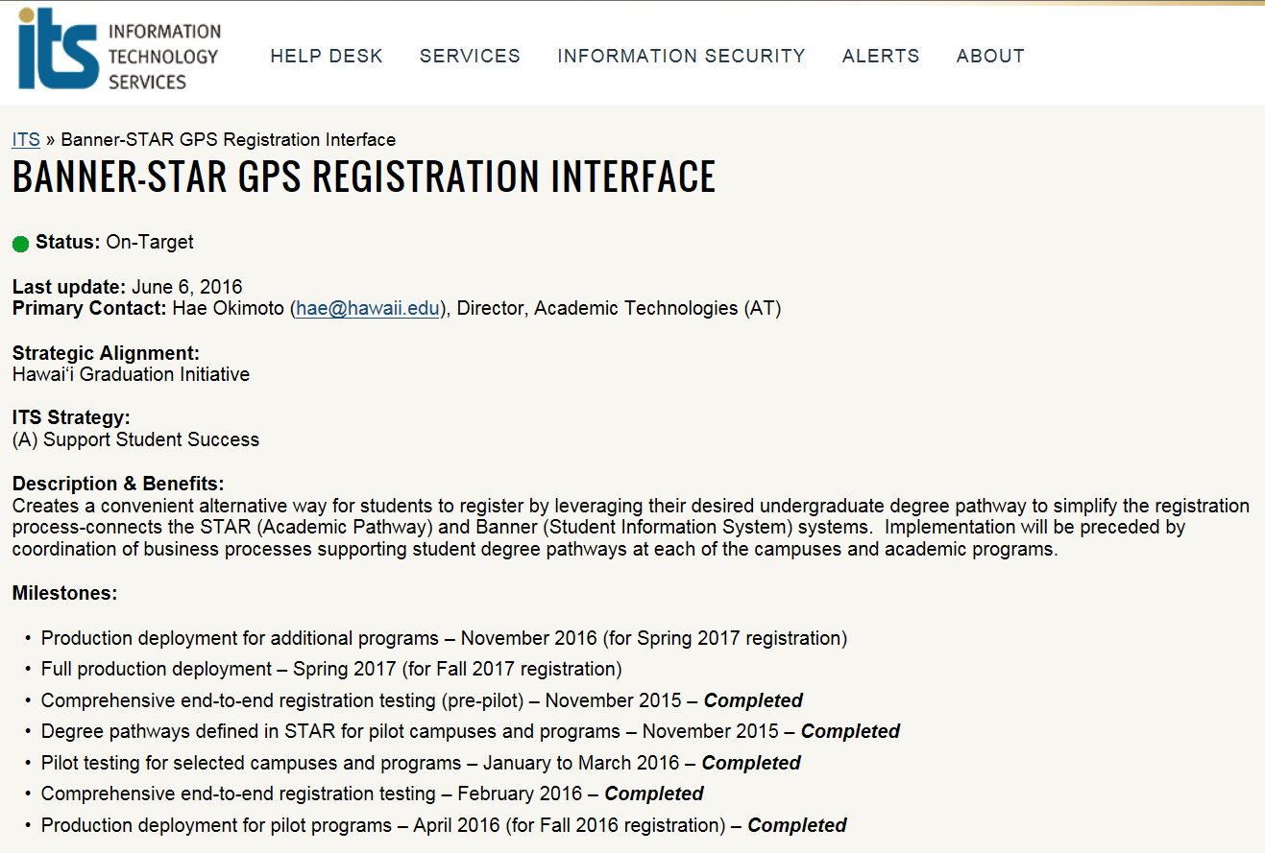

Slide 7
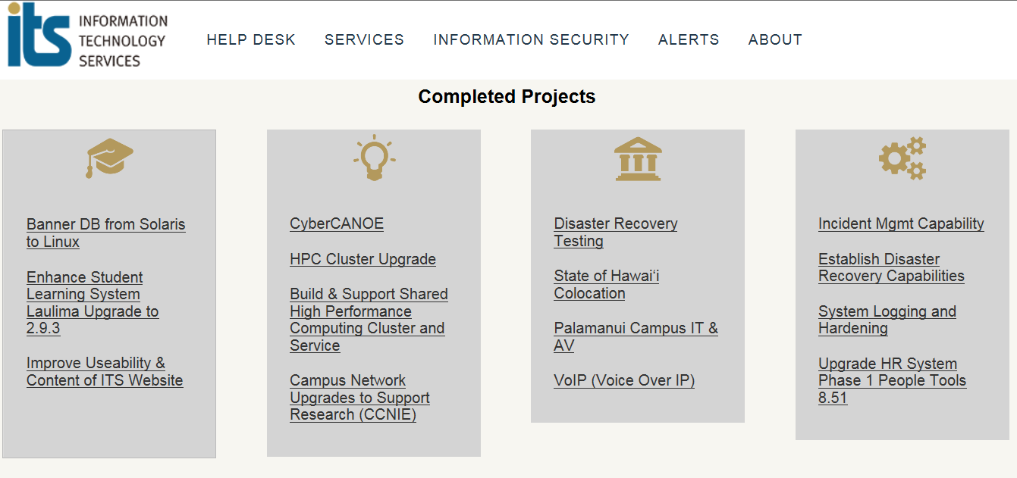

Slide 8
ITS Website
www.hawaii.edu/its
Projects
Lane Fukuda
lanef@hawaii.edu

